Slide 1
Randomized Algorithm

Slide 2
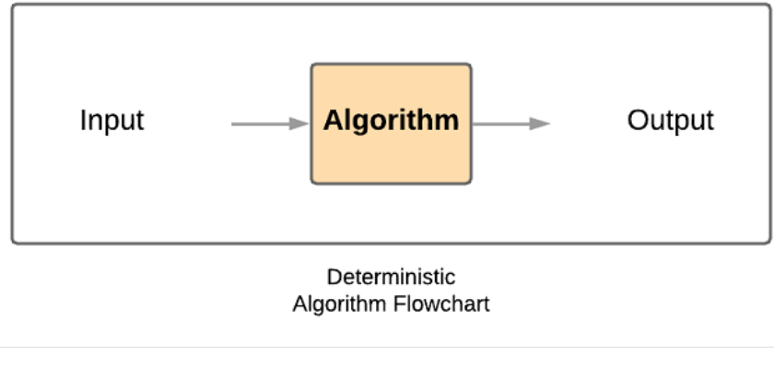
Deterministic algorithm
A standard, deterministic algorithm will always produce the same output given a particular input.
It will always pass through the same steps to reach that output, i.e. its behavior does not change on different runs.
A real life example of this would be a known chemical reaction.
Two parts hydrogen and one part oxygen will always make two molecules of water.
The goal of a deterministic algorithm is to always solve a problem correctly and quickly (in polynomial time). This is what a flow chart of its process looks like:

Slide 3
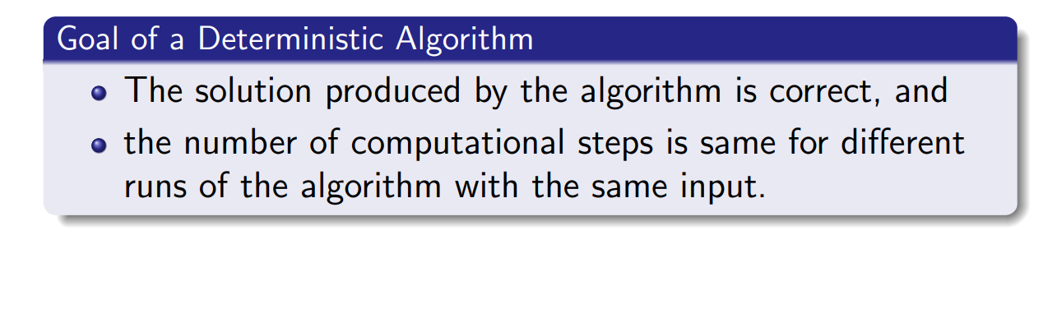
Deterministic algorithm

Slide 4
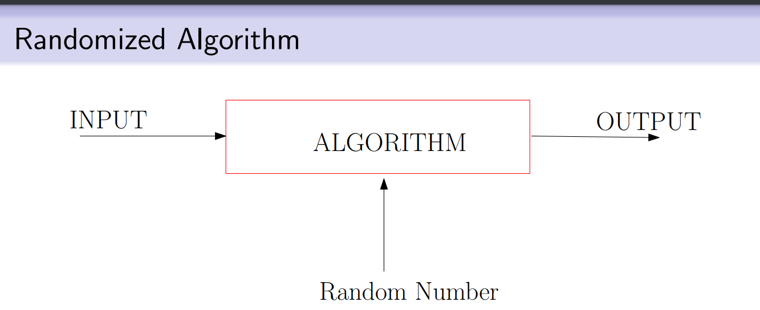
Randomized algorithm

Slide 5
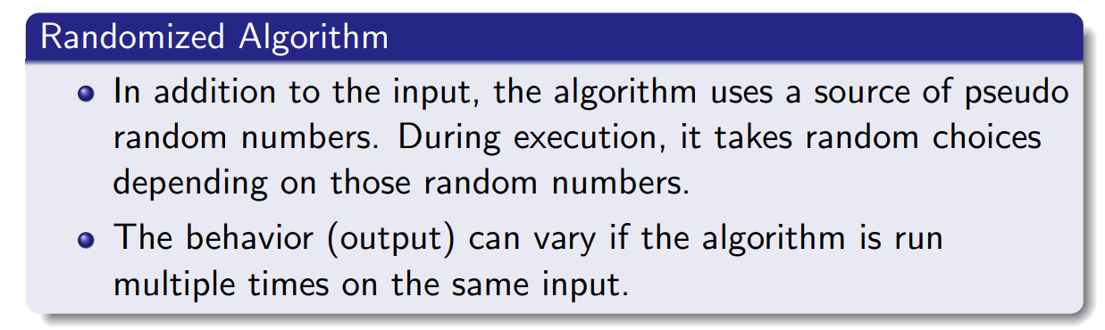
Here, in addition to input, the algorithm uses random numbers to make random choices during execution.
For the same input there can be different output, i.e. its behavior changes with different runs.
These algorithms depend upon Random Number Generators.
Note that this is different from the probabilistic analysis of algorithms, wherein random input is used to show that the algorithm works for most inputs.

Slide 6
When are randomized algorithms used?
They are used whenever we are presented with time or memory constraints, and when an average case solution is acceptable. So you will see randomized algorithms in fields such as:
Number theoretic algorithms – Primality Testing
Data Structures – Searching, sorting, computational geometry
Algebraic Identities – Verification of polynomial and matrix identities
Mathematical Programming – Faster linear programming algorithms
Graph algorithms – Finding minimum spanning trees, shortest paths, minimum cuts

Slide 7
in Quicksort,the worst case for quick sort is to come across a list that is already mostly sorted (the time complexity shoots up to O(n²).
Randomized Quicksort avoids this by shuffling the positions of the elements in the list, and on average Quicksort is able to sort in O(nlogn) time.

Slide 8

Definition of randomized algorithm
An algorithm that uses random numbers to decide what to do next anywhere in its logic is called a Randomized Algorithm.
For example, in Randomized Quick Sort, we use a random number to pick the next pivot

Slide 9
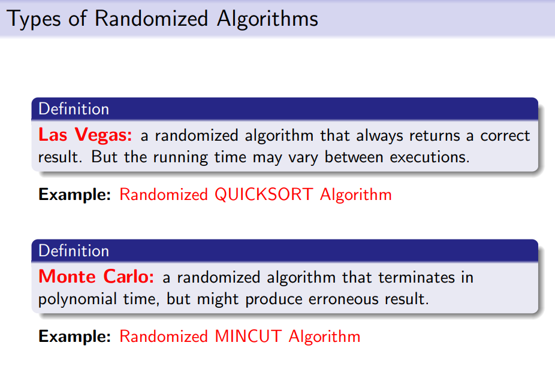

Slide 10
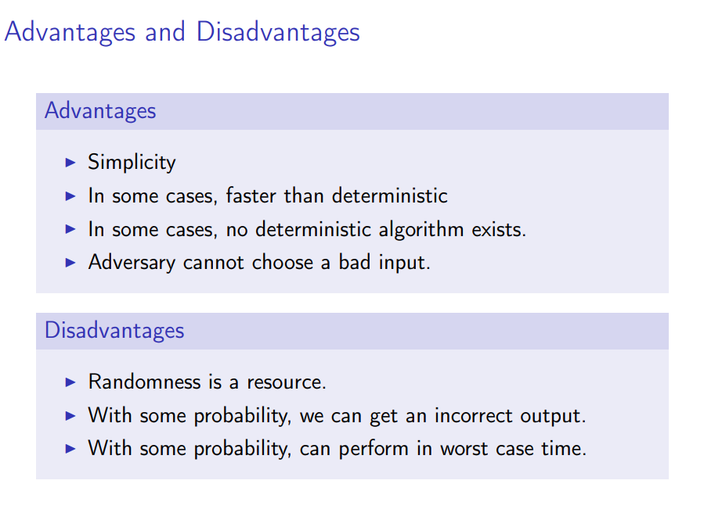

Slide 11
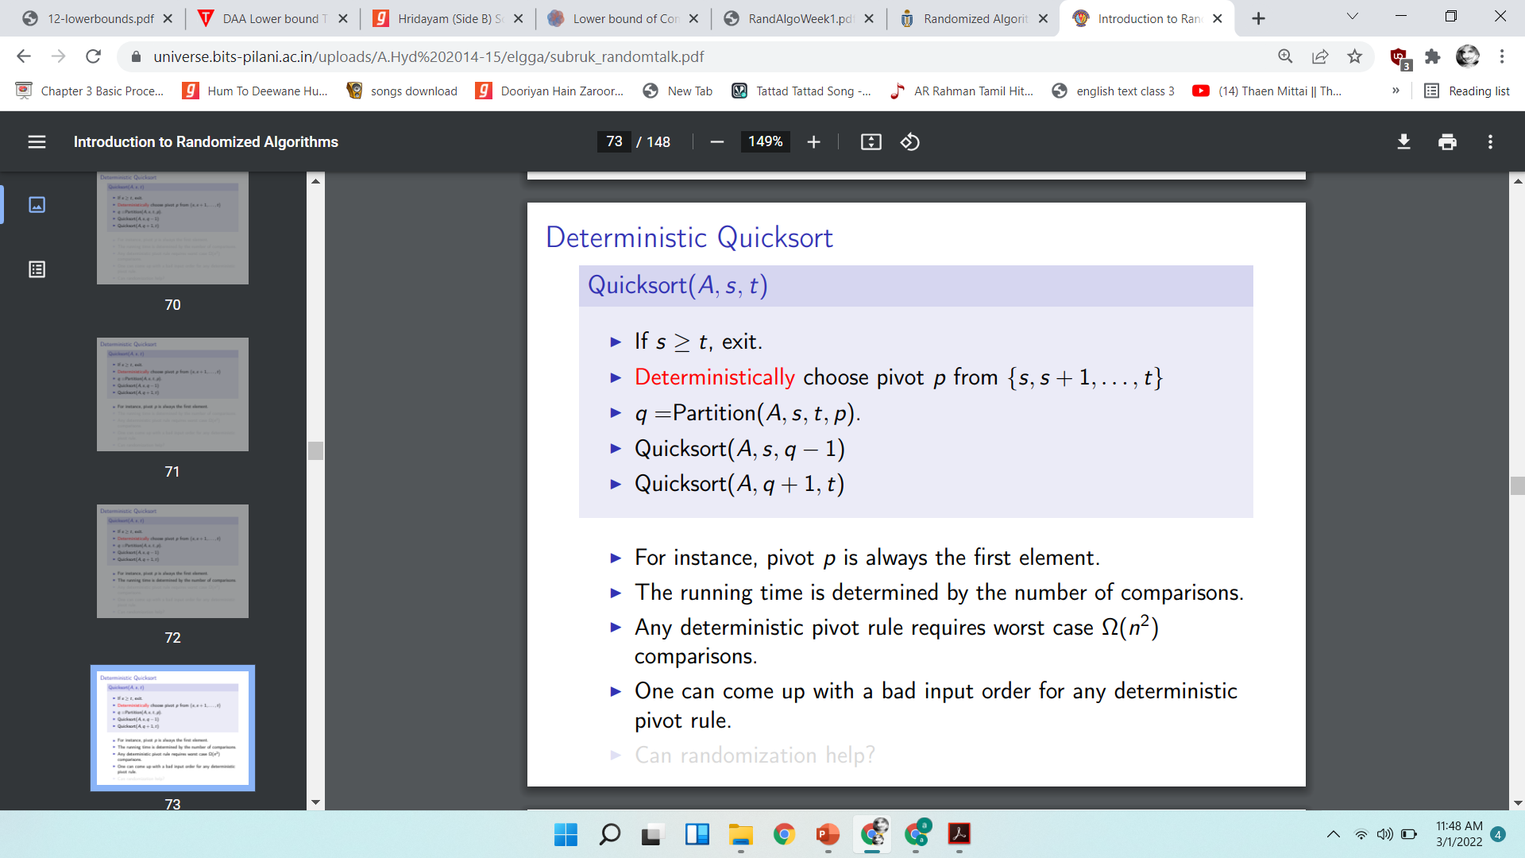

Slide 12
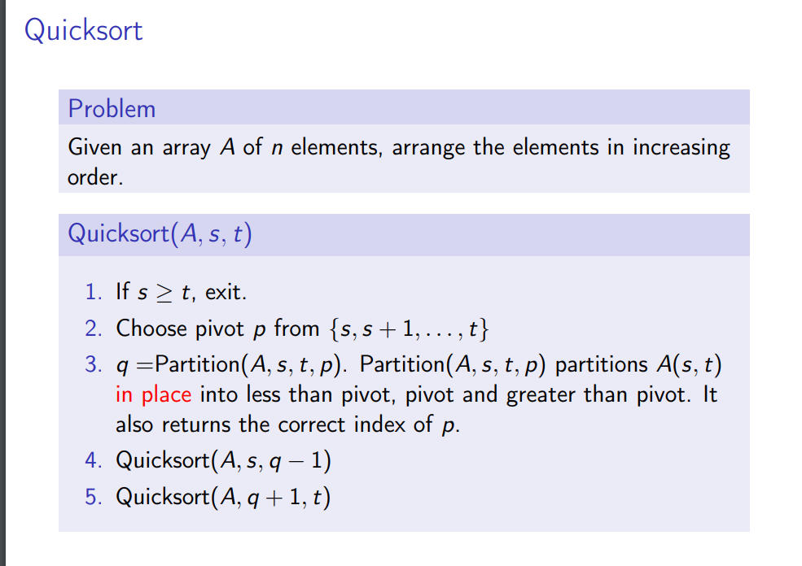
Randomized quicksort

Slide 13
Schwartz-Zippel Lemma and Polynomial Identity Testing

Slide 14
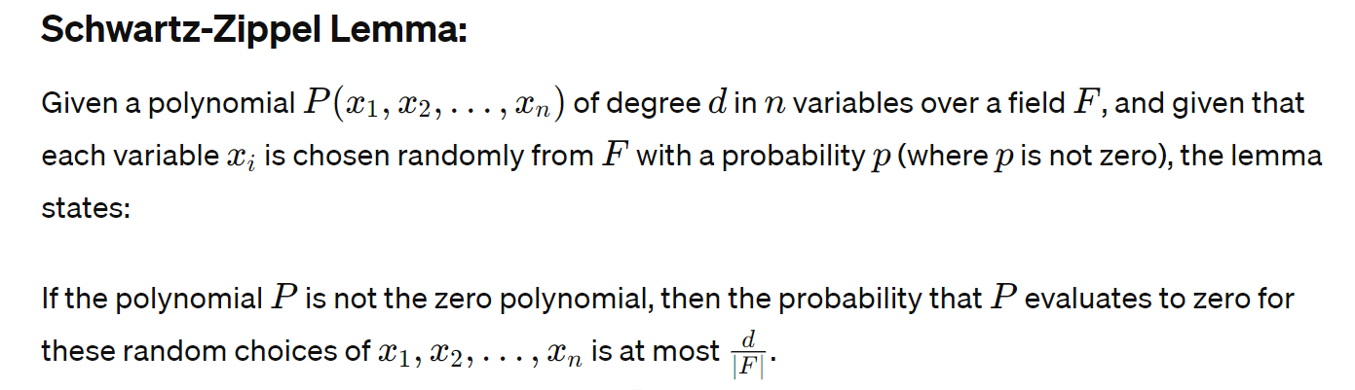

Slide 15
Polynomial Identity Testing (PIT):
The Schwartz-Zippel lemma is often used in Polynomial Identity Testing, a crucial problem in computer science and mathematics.
PIT involves determining whether a given algebraic expression or polynomial is identically zero for all possible values of its variables.
This problem has applications in error-correcting codes, computational algebra, and complexity theory.
Using the Schwartz-Zippel lemma, a randomized algorithm for PIT can be formulated.
The algorithm randomly selects values for the variables and evaluates the polynomial.
If the polynomial evaluates to zero for these randomly chosen values, it is likely that the polynomial is identically zero.

Slide 16
However, if it does not evaluate to zero, then with high probability, the polynomial is not identically zero.
Although the algorithm is probabilistic (it may produce incorrect results with a small probability for non-zero polynomials), it runs efficiently and is particularly useful for large-degree polynomials or in cases where deterministic algorithms are impractical.
The Schwartz-Zippel lemma and randomized algorithms for polynomial identity testing are significant in theoretical computer science, offering practical methods for solving problems related to algebraic identities and polynomial equations in complex systems.

